Slide 1
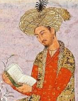
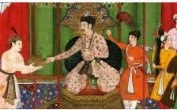
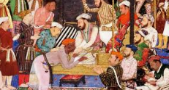
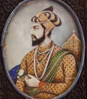
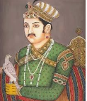
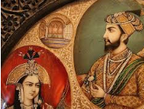
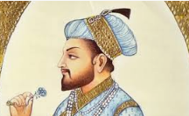
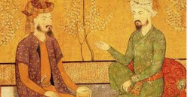
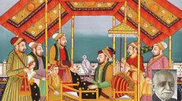
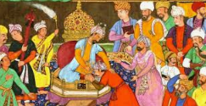
THE MUGHAL EMPIRE
HISTORY CHAPTER-4

Slide 2
LEARNING OBJECTIVES
To trace the political history of 16th and 17th century.
Understand the impact of imperial administration at the local and regional levels.
Appreciate how the various historical sources of history are used to reconstruct history.

Slide 3
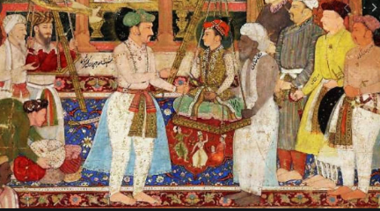
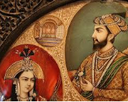
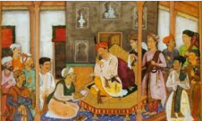
SIGNIFIANCE OF MUGHAL RULE
The Mughals ruled effectively a very large territory for a very long time despite the diversity of people and cultures which was an extremely difficult task for any ruler to accomplish in the Medieval period
From late 16th century Mughals expanded their kingdom from Agra and Delhi and by the 17th century they controlled nearly all of the subcontinent.
They imposed effective structures of administration – (mansabdari, Zabti Land Revenue systems etc )
They introduced new ideas of governance that outlasted their rule leaving a political legacy .
Left a cultural legacy –new language , religion , crafts , literature , imposing architecture etc

Slide 4
ORIGINS OF MUGHAL EMPIRE
The Mughals were descendants of two great lineages of rulers.
From their mother’s side they were descendants of Genghis Khan , the Mongol ruler of China and Central Asia.
From their father’s side they were the successors of Timur ,the ruler of Iran, Iraq and modern-day Turkey.
But , the Mughals did not like to be called Mughal or Mongol because Genghis Khan’s memory was associated with the massacre of innumerable people. And It was also linked with the Uzbegs, their Mongol competitors.
On the other hand, the Mughals were proud of their Timurid ancestry, because their great ancestor had captured Delhi in 1398.
They over emphasised this and celebrated their genealogy pictorially, each ruler getting a picture made of Timur and himself

Slide 5
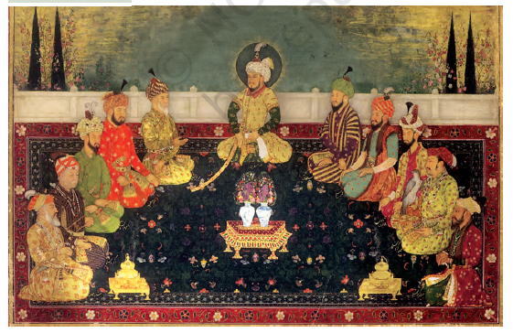
A miniature painting (dated 1702-1712) of Timur, his descendants and the Mughal emperors. Timur is in the centre and on his right is his son Miran Shah (the first Mughal emperor Babur’s great-greatgrandfather) and then Abu Said (Babur’s grandfather). To the left of Timur are Sultan Muhammad Mirza (Babur’s great-grandfather) and Umar Shaikh (Babur’s father). The Mughal emperors Babur, Akbar and Shah Jahan are the third, fourth and fifth individuals on Timur’s right and on his left, in the same order, are Humayun, Jahangir and Aurangzeb.

Slide 6
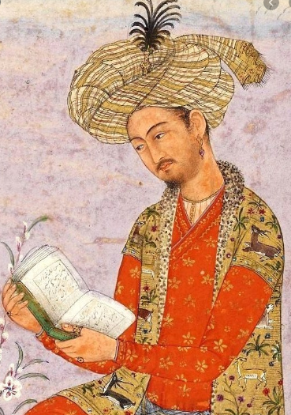
BABUR (1526-30) , was the first Mughal emperor who succeeded to the
throne of Ferghana (Uzbekistan) in 1494 at the age of 12 years.
He was forced to leave his ancestral throne due to invasion of another Mongol group, Uzbegs .
He seized Kabul (Afghanistan )in 1504. After facing few defeats at the hands of Uzbeks
he turned his attention towards Indian Subcontinent .
THREE MAJOR BATTLES OF BABUR
(First Battle of Panipat) -In 1526 he defeated the Lodhi Sultan of Delhi, Ibrahim Lodi at Panipat and captured Delhi and Agra.
(Battle of Khanwa ) in 1527- Babur defeated Rana Sanga, the Rajput ruler and his allies
(Battle of Chanderi) in 1528- he defeated the Rajputs decisively and Established control over Agra and Delhi before his death.
CHANGE IN WARE FARE TECHNIQUES
Babur used them CANNONS in the first battle of Panipat. Cannons were an important addition in 16th century warfare. GUNPOWDER TECHNOLOGY was brought to India in the 14th century .
FIRE ARMS were used for the first time in regions such as Gujarat, Malwa and Deccan

Slide 7
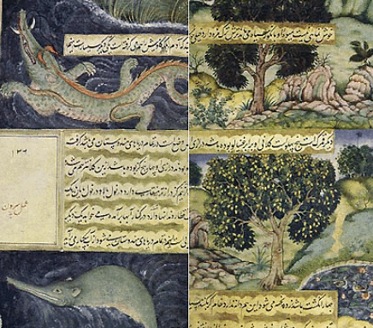
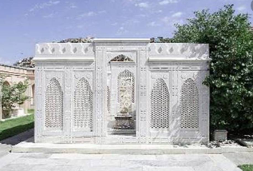
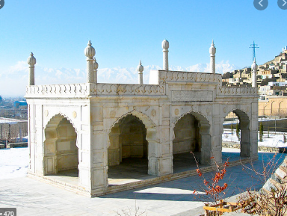
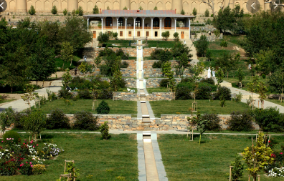
Tomb of Babur , Kabul
TUZUK-E-BABURI or Baburnama)
World Heritage Site – Bagh-e- Babur , Kabul , Afganisthan
Char Bagh Concept – Babur Gardens , Kabul

Slide 8
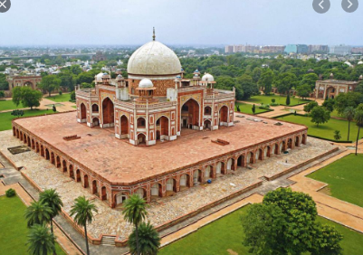
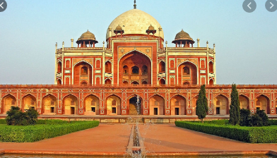
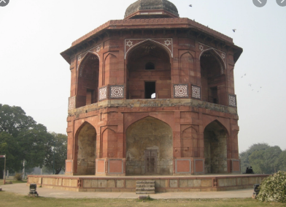
HUMAYUN (1530-1540, 1555-1556)
Humayun divided his inheritance according to the will of his father and therefore His brothers were each given a province.
The ambitions of his brother Mirza Kamran weakened Humayun’s cause against Afghan competitors (Sher Shah ).
Sher Khan defeated Humayun twice once at Chausa (Battle of Chausa-1539) and (Battle of Kanauj -1540) forcing him to flee to Iran and take refuge with Safavid Shah.
While he was in exile , his young son Akbar was kept under the regency of Bairam Khan .
Humayun recaptured Delhi in 1555 but died the next year after falling off the stairs of his Library in Purana Qilla (Sher Mandal).
HUMAYUN TOMB, DELHI
SHER MANDAL , PURANA QILA

Slide 9
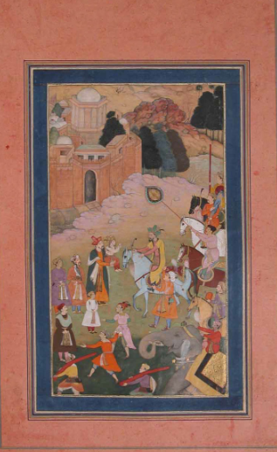
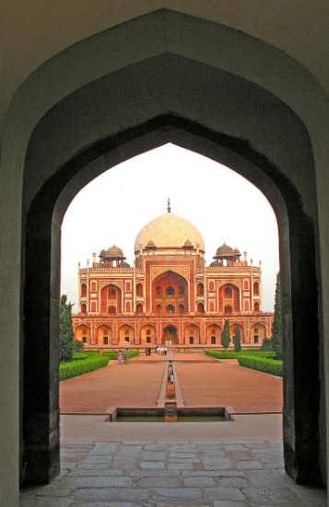
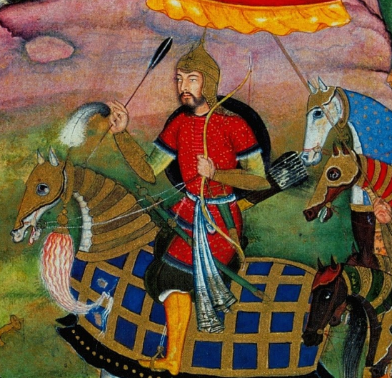
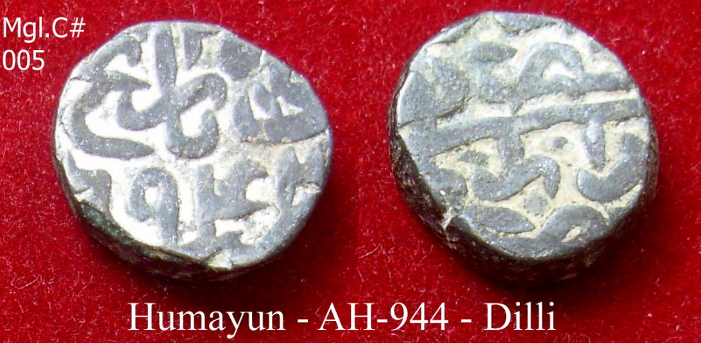
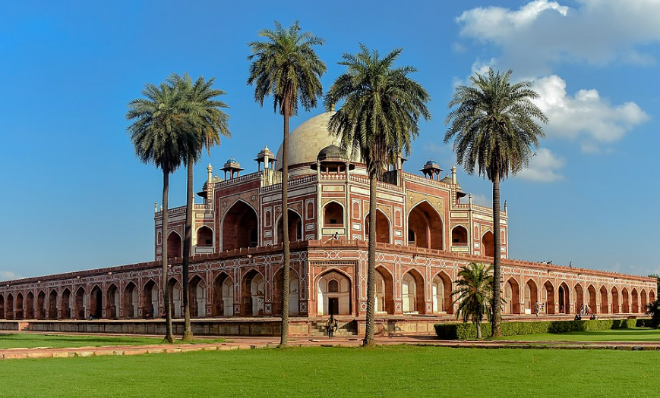
Painting of Humayun
Painting showing Humayun being Reunited with young Akbar
HUMAYUN’S Tomb
Silver coins issued by Humayun

Slide 10
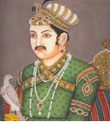
AKBAR (1556-1605)
became emperor at the tender age of 13. One of the greatest Mughal rulers of all .
Only Mughal emperor who was illiterate but still was extremely wise and
knowledgeable, But he had liking for learning !!
Akbar’s reign can be divided into three broad periods.
(1) 1556-1570
Akbar became independent of the regent Bairam Khan and his domestic staff.
Military campaigns were launched against the Suris and other Afghans,
Military campaigns against the neighbouring kingdoms of Malwa and Gondwana,
Suppression of the revolt of his half-brother Mirza Hakim
Suppression of the Uzbegs.
In 1568 the Sisodiya capital of Chittor was seized and in 1569 Ranthambhor.
(2) 1570-1585
Western military campaigns in Gujarat
Eastern military Campaigns in Bihar, Bengal and Orissa..
(3) 1585-1605 – Further expansion of Akbar’s empire.
North Western Campaigns were launched . Qandahar was seized from the Safavids, Kashmir was annexed, Kabul, after the death of Mirza Hakim.
Deccan Campaigns started and Berar, Khandesh and parts of Ahmadnagar were annexed.

Slide 11
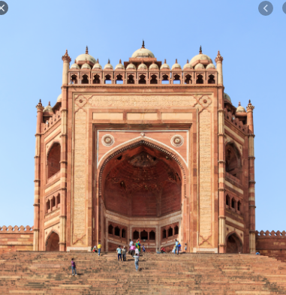
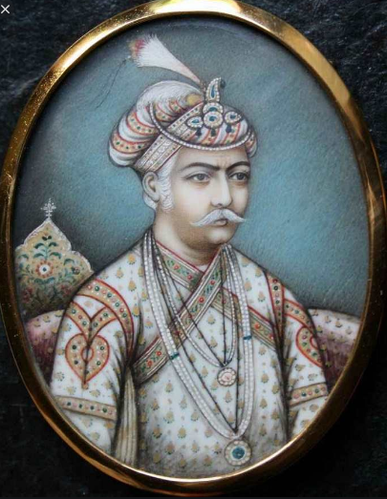
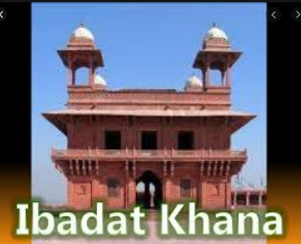
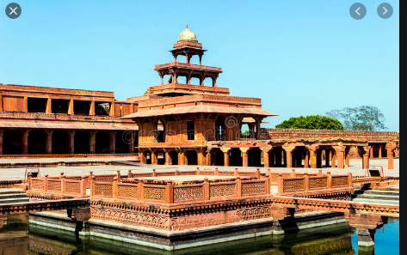
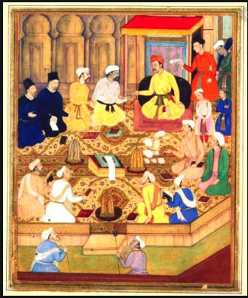
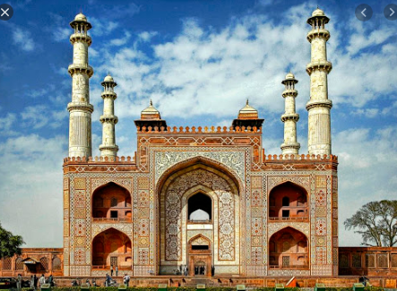

Slide 12
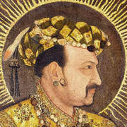
JAHANGIR (1605-1627)
Military campaigns started by Akbar continued.
The Sisodiya ruler of Mewar, Amar Singh, accepted
Mughal service.
Less successful campaigns against the Sikhs, the Ahoms and Ahmadnagar in deccan followed.
Rebellion of Prince Khurram, the future Emperor Shah Jahan in the last years of his reign.
Nur Jahan, Jahangir’s wife , wielded lot of influence on Jahangir but her attempts to marginalise Shah Jahan were unsuccessful.
Jahangir had great love for Paintings

Slide 13
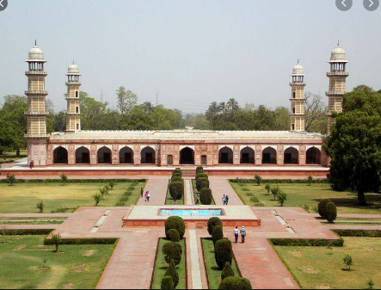
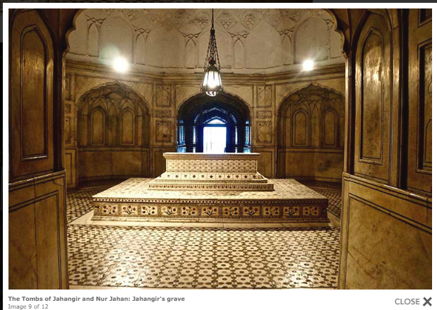
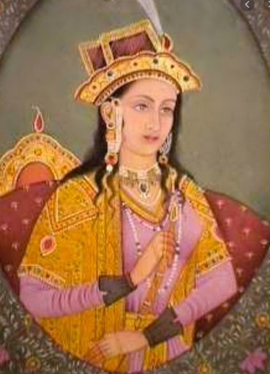
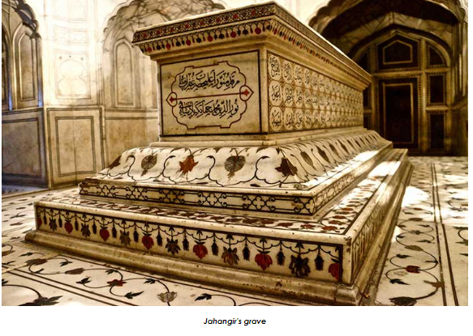
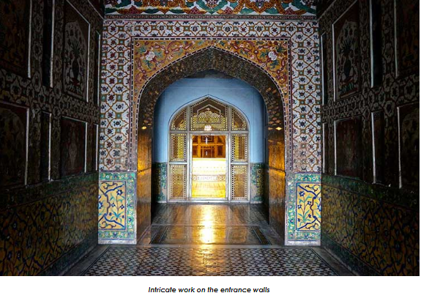
Tomb of Jahengir and Noor Jahan , Lahore
Noor jahan

Slide 14
SHAH JAHAN 1627-1658
Mughal Deccan campaigns Continued under Shah Jahan.
The Bundelas were defeated and Orchha seized.
In the north-west, Qandahar was lost to the Safavids.
In 1632 Ahmadnagar and Bijapur Conquered .
In 1657-1658, there was war of succession amongst Shah Jahan’s 4 sons.
Aurangzeb was victorious and his three brothers, including Dara Shukoh, were killed.
Shah Jahan was imprisoned for the rest of his life in Agra by son Aurangzeb.
Shah Jahan was patron of Art and Architecture –many grand buildings were made during his rule –An Engineer’s King

Slide 15
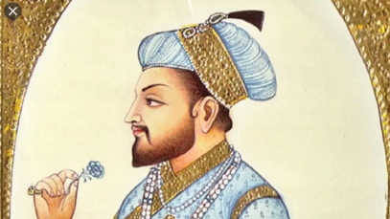
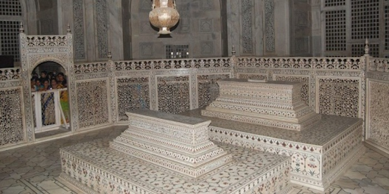
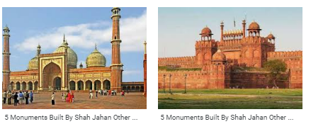
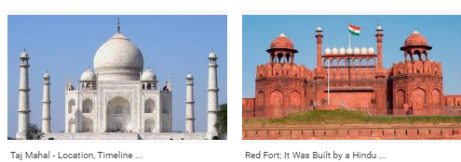
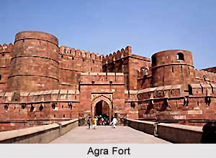
SHAH JAHAN – ENGINEER’S KING

Slide 16
AURANGZEB (1658-1707)
(1) EARLY YEARS CAMPIAGNS
In the north-east, the Ahoms were defeated in 1663, but rebelled again in 1680s.
In north-west campaigns against the Yusufzai and the Sikhs were temporarily successful.
He started interfering in the succession and internal politics of the Rathor Rajputs of Marwar leading to Rajput rebellion.
Campaigns against the Maratha chieftain Shivaji were initially successful. But Aurangzeb insulted Shivaji who escaped from Agra, declared himself an independent king and resumed his campaigns against the Mughals.
Prince Akbar rebelled against Aurangzeb and received support from the Marathas and the Deccan Sultanate.
(2) LATER YEARS
Aurangzeb sent armies against the Deccan Sultanates.
Bijapur was annexed in 1685
Golconda was annexed in 1687. From 1698
Aurangzeb personally managed campaigns in the Deccan against the Marathas who started guerrilla warfare.
Aurangzeb also had to face the rebellion in north India of the Sikhs, Jats and Satnamis, in the north-east of the Ahoms and in the Deccan of the Marathas.
(3) His death was followed by a STURUGGLE FOR SUCCESSION - conflict amongst his sons

Slide 17
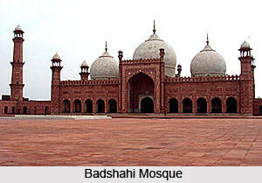
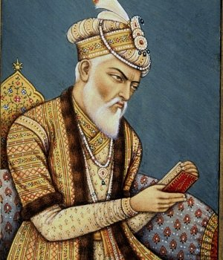
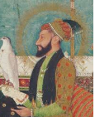
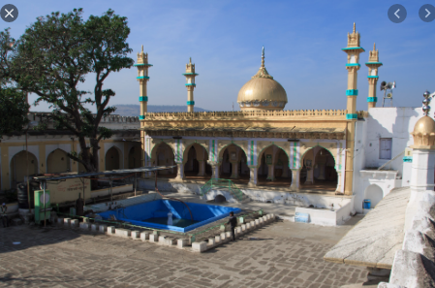
LAHORE
AURANGZEB’S TOMB, AURANGABAD

Slide 18
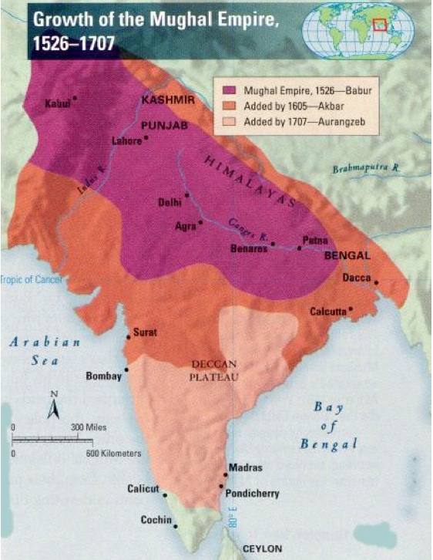


Slide 19



Slide 20
PART 2

Slide 21
MUGHAL TRADITIONS OF SUCCESSION
The Mughals did not believe in the RULE OF PRIMOGENITURE, where the eldest son inherited his father’s estate.
Instead they followed the Mughal and Timurid custom of COPARCENARY INHERITANCE, or a division of the inheritance amongst all the sons.
This often led to WAR OF SUCCESSION amongst the sons of rulers /Princes
For Eg.
Akbar’s Half Brother Mirza Hakim revolted many times during his rule
In the last years of Akbar’s reign ,Prince Salim, the future Emperor Jahangir also had revolted against the emperor.
Prince Khurram, the future Emperor Shah Jahan, rebelled in the last years of Jahengir’s reign.
In 1657-1658, there was conflict over succession amongst Shah Jahan’s sons. Aurangzeb was victorious and his three brothers,i ncluding Dara Shukoh, were killed.
Prince Akbar rebelled against Aurangzeb and received support from the Marathas and the Deccan Sultanate.

Slide 22

MUGHAL RELATIONS WITH OTHER RULERS-RAJPUTs
SUBMISSION -As the Mughals became powerful many rulers also joined them voluntarily and accepted Mughal Suzerainty .
Those Rajputs who submitted voluntarily , the Mughals followed POLICY OF NON INTERVENTION in their internal matters of Kingdom .
WARS & BATTLES -The Mughal rulers campaigned constantly against rulers who refused to accept their authority.
For eg: The Sisodiya Rajputs of Mewar refused to accept Mughal authority for a long time. They were defeated in a fierce Battle of Haldighati
However once defeated , they were HONOURABLY TREATED by the Mughals, given their lands (WATAN) back as assignments (WATAN JAGIR).
HIGH TITLES AND RANKS were given to some Rajputs rulers in the Mughal administration.
MATRIMONIAL ALLIANCES -Many Rajputs married their daughters into Mughal families and received high positions.
(Akbar' Wife and mother of Jahangir was a Kachhwaha princess, daughter of the Rajput ruler of Amber (Jaipur)
Jahengir's Wife and mother of Shah Jahan was a Rathor princess, daughter of the Rajput ruler of Marwar (Jodhpur).
The careful balance between defeating but not humiliating their opponents enabled the Mughals to extend their influence over many kings and chieftains of the Indian Subcontinent .

Slide 23


Akbar made deliberate attempt to win Rajputs to his side and get their support in the expansion and consolidation of Mughal rule in India.
HE was very successful in his endeavour.
His Rajput Policy brought decline in the number and magnitude of revolts of the Rajputs.
Akbar could con­centrate more on his administrative and other reforms.
Thus Akbar’s regime marks the beginning of cooperation and friendly relations of Mughals and Rajputs.
This Policy was followed by his successors Jahengir, Shah Jahan also . The break in this policy came during the reign of Aurangzeb .

Slide 24



The Mughals recruited administrative and Military officials from diverse groups
Turkish nobles(Turanis)
Iranians (Persians)
Indian Muslims
Afghans
Rajputs
Marathas and other groups.
Those who joined Mughal service were enrolled as MANSABDARS.

Slide 25

MANSABDARI SYSTEM
The term MANSABDAR refers to an administrative or military offiial
who holds a mansab, meaning a position or rank.
Mansabdari system was a GRADING SYSTEM used by the Mughals to fix:-
(1) rank of the official
(2) salary of the official
(3) military responsibilities.
Rank and salary were determined by a numerical value called ZAT (rank ). The higher the zat, the more prestigious was the noble’s position in court and the larger his salary.
The mansabdar’s military responsibilities required him to maintain a specified number of SAWAR or cavalrymen.
The mansabdar brought his cavalrymen for review and got them registered (CHEHRA )
They also got their horses branded (Dagh)and then received money to pay them as salary.
JAGIRDARI - Mansabdars received their salaries as revenue assignments called JAGIRS (Equal to his salary)
But most mansabdars did not actually reside in or administer their jagirs. They only had rights to the revenue of their assignments which was collected for them by their servants while the mansabdars themselves served in some other part of the country.
Some RAJPUTS were given their lands (WATAN) back as assignments (WATAN JAGIR).

Slide 26

ZABT AND ZAMINDARS
The main source of income for Mughal rulers was tax on the produce of the peasantry or Land Revenue .
Peasants paid taxes through the rural elites- the headman or the local chieftain and the Mughals used the term– zamindars – to describe all intermediaries.
ZABT / ZABTI SYSTEM / DAHSALA .
Akbar’s revenue minister, Todar Mal, carried out a careful survey of crop yields, prices and areas cultivated for a 10-year period, 1570-1580.
On the basis of this data, tax was fixed on each crop in cash.
Each province was divided into revenue circles with its own schedule of revenue rates for individual crops. This revenue system was known as Zabt or Zabti or Dahsala .
It was prevalent in those areas where Mughal administrators could survey the land

Slide 27

AKBAR NAMA AND AIN-I AKBARI
Akbar ordered one of his close friends and courtiers, Abul Fazl, to write a history of his reign.
Abul Fazl wrote a three-volume history of Akbar’s reign, titled AKBAR NAMA.
The first volume dealt with Akbar’s ancestors
The second volume recorded the events of Akbar’s reign.
The third volume is the Ain-i –Akbari deals with:-
The broad features of Akbar’s administration,
The household, army, the revenues and the geography of his empire.
It also provides rich details about the traditions and culture of the people living in India.
The most interesting aspect about the Ain-i Akbari is its rich statistical details about things as diverse as crops, yields, prices, wages and revenues.

Slide 28
MUGHAL ADMINISTRATION
Mughal Administration was highly centralized where the king was all supreme
Empire was divided into provinces called subas, governed by a subedar (Governor) who carried out both political and military functions.
Each province also had a financial officer or diwan.
For the maintenance of peace and order in his province, the subedar was supported by other officers such as the military paymaster (Mir bakhshi)
The minister in charge of religious and charitable patronage (sadr)
Military commanders were called (faujdars) and the town police commander (kotwal).
Akbar’s nobles commanded large armies and had access to large amounts of revenue.
While they were loyal (under a strong king ) the empire functioned efficiently but by the end of the seventeenth century many nobles had built independent networks of their own and their loyalties to the empire were weakened by their own self-interest !

Slide 29
RELIGIOUS POLICY -AKBAR
In the later years of his rule Akbar became DISILLUSIONED with Orthodox religion and became more liberal . An era of RELIGIOUS TOLERANCE started ..
While Akbar was at Fatehpur Sikri during the 1570s , he started discussions with many religious heads of all major religions ie. with the ulama, Brahmanas, Jesuit priests ,Roman Catholics, and Zoroastrians etc . in the special building Ibadat khana.
Discussions made him realise that religious scholars who emphasised rituals and dogma were often bigot and Their teachings created divisions and disharmony amongst his subjects.
This eventually led Akbar to the idea of sulh-i kul or “UNIVERSAL PEACE” an idea of tolerance which did not discriminate between people of different religions in his realm. It was a system of ethics – honesty, justice, peace–universally applicable.
Abul Fazl helped Akbar in framing a vision of governance around this idea of sulh-i kul. This principle of governance was followed by Jahangir and Shah Jahan as well.
DIN-E ILLAHI ( “the religion of God,” was a system of religious beliefs introduced by the Mughal emperor Akbar in 1582 CE)
Aboilishion of Jiziya and Pilgrimage tax on Non muslims .
Did not force his religion (Islam or even Din-e-illahi) on anyone
Akbar’s Rajput Policy motivated by these ideas of religious tolerance and Sulh-e-kul

Slide 30
THE MUGHAL EMPIRE IN THE SEVENTEENTH CENTURY AND AFTER
The administrative and military efficiency of the Mughal Empire led to great economic and commercial prosperity.
International travellers described it as
1. the land of wealth
2. poverty that existed side by side with the greatest opulence
The Mughal emperors and their mansabdars spent much income on salaries and goods. This benefited those artisans and peasants who supplied them with goods and produce.
But the peasant and the artisans in general, lived in poor conditions due to high land revenue and taxes.
The Mughal elite commanded enormous wealth and resources which made them an extremely powerful group of people in the late seventeenth century.
As the authority of the Mughal emperor slowly declined,some of his servants emerged as powerful centres of power in the local regions. They went on to constitute new dynasties in provinces like Hyderabad and Awadh.
Although they continued to recognise the Mughal emperor in Delhi as their master, by the eighteenth century the provinces of the empire had consolidated their independent political identities.

Slide 31
DECLINE OF MUGHALS –LATER MUGHALS
Mughal emperors after Aurangzeb were called “Later Mughals” .
(Later Mughal ) Quick successions and Weak rulers
Vastness of empire –Difficult to manage
Corruption of Mansabdari and Jagirdaari system.
Impact of Aurangzeb’s Orthodox policies
Peasant unrests and Revolts of Sikh, Rajputs etc
Local elite and Mughal Governors took advantage

Slide 32
THANK YOU!

